Slide 2
Numpy
NumPy, short for Numerical Python, is a fundamental open-source library in Python for scientific computing. It provides support for large, multi-dimensional arrays and matrices, along with a collection of high-level mathematical functions to operate efficiently on these arrays.

Slide 3
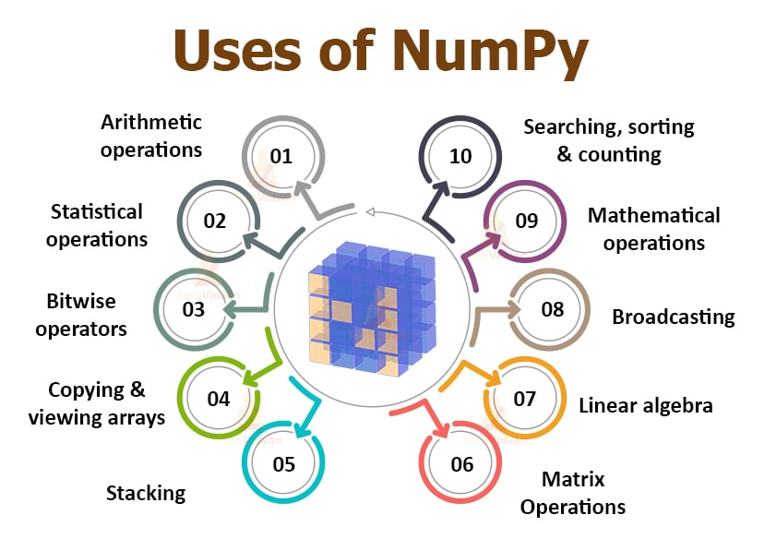

Slide 4
1. Importing NumPy
import numpy as np
# 2. Creating Arrays
a = np.array([1, 2, 3]) # 1D array
b = np.array([[1, 2], [3, 4]]) # 2D array
zeros = np.zeros((2, 3)) # array of zeros
ones = np.ones((2, 3)) # array of ones
full = np.full((2, 2), 7) # array filled with 7
eye = np.eye(3) # identity matrix
arange = np.arange(0, 10, 2) # range with step
linspace = np.linspace(0, 1, 5) # equally spaced numbers

Slide 5
Array Attributes
#3. Array Attributes
arr = np.array([[1,2,3],[4,5,6]])
print(arr.shape) # (2,3)
print(arr.ndim) # 2
print(arr.size) # 6
print(arr.dtype) # int64 (depends on system)
print(arr.itemsize) # bytes per element

Slide 6
Indexing & Slicing
# 4. Indexing & Slicing
arr = np.array([10,20,30,40,50])
print(arr[0]) # 10
print(arr[-1]) # 50
print(arr[1:4]) # [20 30 40]
mat = np.array([[1,2,3],[4,5,6]])
print(mat[0,1]) # 2
print(mat[:,1]) # column [2 5]
print(mat[1,:]) # row [4 5 6]

Slide 7
Mathematical Operations
#5. Mathematical Operations
x = np.array([1,2,3])
y = np.array([4,5,6])
print(x + y) # [5 7 9]
print(x - y) # [-3 -3 -3]
print(x * y) # [ 4 10 18]
print(x / y) # [0.25 0.4 0.5 ]
print(np.power(x, 2)) # [1 4 9]

Slide 8
Aggregate Functions
arr = np.array([1,2,3,4,5])
print(arr.sum()) # 15
print(arr.mean()) # 3.0
print(arr.min()) # 1
print(arr.max()) # 5
print(arr.std()) # 1.414..
print(arr.var()) # 2.0

Slide 9
Reshaping
arr = np.arange(1,7) # [1 2 3 4 5 6]
reshaped = arr.reshape(2,3)
# [[1 2 3]
# [4 5 6]]
flat = reshaped.ravel() # back to 1D

Slide 10
Stacking & Splitting
NumPy provides various functions for both stacking (joining) and splitting arrays, allowing for flexible manipulation of data structures.
a = np.array([[1,2],[3,4]])
b = np.array([[5,6],[7,8]])
print(np.hstack((a,b)))
# [[1 2 5 6]
# [3 4 7 8]]

Slide 11
Stacking & Splitting
print(np.vstack((a,b)))
# [[1 2]
# [3 4]
# [5 6]
# [7 8]]
arr = np.array([1,2,3,4,5,6])
print(np.split(arr, 3)) # [array([1,2]), array([3,4]), array([5,6])]

Slide 12
Random Module
print(np.random.rand(3)) # random floats [0,1)
print(np.random.randn(2,2)) # normal distribution
print(np.random.randint(1,10,5)) # random ints
print(np.random.choice([1,2,3])) # random element

Slide 13
Linear Algebra
A = np.array([[1,2],[3,4]])
B = np.array([[5,6],[7,8]])
print(np.dot(A,B)) # matrix multiplication
print(np.linalg.inv(A)) # inverse
print(np.linalg.det(A)) # determinant
print(np.linalg.eig(A)) # eigenvalues & vectors

Slide 14
Useful Functions
arr = np.array([1,2,3,4,5])
print(np.unique(arr)) # unique values
print(np.sort(arr)) # sort
print(np.where(arr>2)) # indices where condition holds
print(np.clip(arr, 2, 4)) # limit values [2 2 3 4 4]
print(np.argmax(arr)) # index of max → 4
print(np.argmin(arr)) # index of min → 0

Slide 15
Pandas
Pandas is a popular open-source software library written for the Python programming language, specifically designed for data manipulation and analysis. It provides powerful and flexible data structures, primarily the DataFrame and Series, which are optimized for working with "relational" or "labeled" data.

Slide 16
Introduction
import numpy as np
pandas = data analysis library
#Works with Series (1D) and DataFrame (2D)

Slide 17
Pandas Data Structures
#Series (1D)
s = pd.Series([10, 20, 30], index=["a", "b", "c"])
print(s)
# DataFrame (2D)
data = {"Name": ["Alice", "Bob", "Charlie"], "Age": [25, 30, 35]}
df = pd.DataFrame(data)
print(df)

Slide 18
Reading & Writing Data
df = pd.read_csv("data.csv") # Read CSV
df.to_csv("output.csv", index=False) # Save CSV
df = pd.read_excel("data.xlsx") # Read Excel
df.to_excel("output.xlsx", index=False)

Slide 19
Basic Info & Exploration
print(df.head()) # first 5 rows
print(df.tail(3)) # last 3 rows
print(df.shape) # rows, cols
print(df.info()) # data types
print(df.describe()) # summary stats
print(df.columns) # column names
print(df.dtypes) # column types

Slide 20
Selecting Data
✅ By column
print(df["Name"])
print(df[["Name","Age"]])
✅ By row
print(df.loc[0]) # by index label
print(df.iloc[0]) # by position
✅ Conditional selection
print(df[df["Age"] > 30])

Slide 21
Adding / Modifying Columns
df["Salary"] = [5000, 6000, 7000] # add new
df["Age+5"] = df["Age"] + 5 # derived

Slide 22
Deleting Rows/Columns
df.drop("Salary", axis=1, inplace=True) # drop column
df.drop(0, axis=0, inplace=True) # drop row

Slide 23
Handling Missing Data
df.dropna() # drop missing
df.fillna(0) # replace with 0
df["Age"].fillna(df["Age"].mean(), inplace=True) # replace with mean

Slide 24
Sorting
df.sort_values("Age") # ascending
df.sort_values("Age", ascending=False) # descending

Slide 25
Grouping & Aggregation
df.groupby("Name")["Age"].mean()
df.groupby("Name").agg({"Age": "max"})

Slide 26
Merging & Joining (SQL style)
pd.merge(df1, df2, on="id", how="inner") # inner join
df1.join(df2, how="outer") # index-based join

Slide 27
Concatenation & Append
pd.concat([df1, df2]) # stack vertically
df1.append(df2) # (deprecated, use concat)

Slide 28
Pivot & Crosstab
#Reshapes data: turns unique values of a column into columns.
pd.pivot_table(df, values="Age", index="Name", aggfunc="mean")
#Used to compute frequency tables (counts).
pd.crosstab(df["Name"], df["Age"])

Slide 29
Apply & Lambda
df["Age2"] = df["Age"].apply(lambda x: x*2)

Slide 30
String Operations
df["Name"].str.upper()
df["Name"].str.contains("A")

Slide 31
Date & Time
df["date"] = pd.to_datetime(["2025-01-01", "2025-02-01", "2025-03-01"])
df["year"] = df["date"].dt.year

Slide 32
Window Functions
df["rolling_mean"] = df["Age"].rolling(2).mean()
#Rolling Mean (Moving Average)
df["Rolling_Mean"] = df["Sales"].rolling(window=3).mean()
print(df)
#Like SQL RANK, DENSE_RANK, ROW_NUMBER.
df["Rank"] = df["Sales"].rank(method="dense", ascending=False)
print(df)

Slide 33
Exporting
df.to_csv("out.csv")
df.to_json("out.json")
df.to_excel("out.xlsx")

Slide 34
Visualization (with matplotlib)
import matplotlib.pyplot as plt
df["Age"].plot(kind="hist")
plt.show()

Slide 35
import pandas as pd
import matplotlib.pyplot as plt
# Create a sample DataFrame
data = {
"Product": ["Laptop", "Mobile", "Tablet", "Headphone", "Camera"],
"Sales": [120, 300, 180, 90, 150]
}
df = pd.DataFrame(data)
print(df)
# Plot Bar Graph
plt.bar(df["Product"], df["Sales"], color="skyblue", edgecolor="black")
plt.title("Product Sales")
plt.xlabel("Product")
plt.ylabel("Sales Units")
plt.show()

